Slide 1

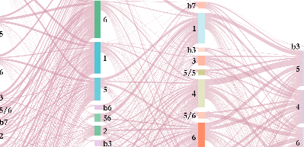
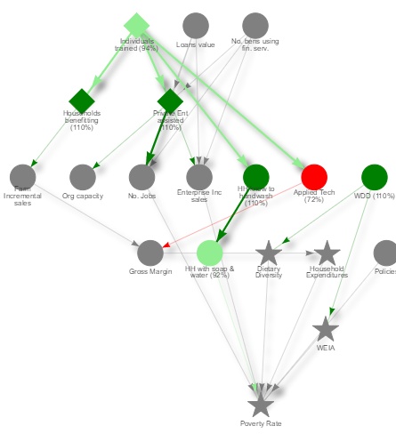
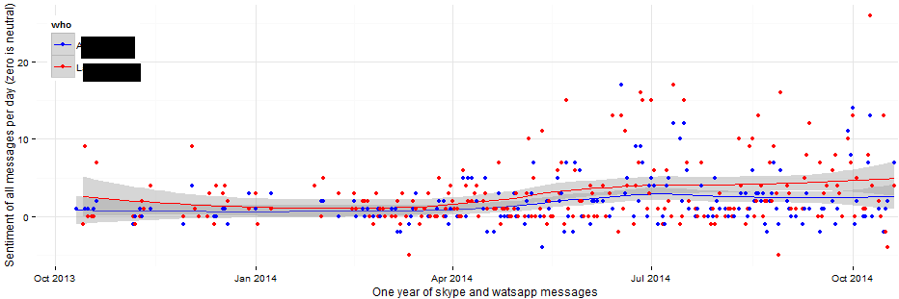

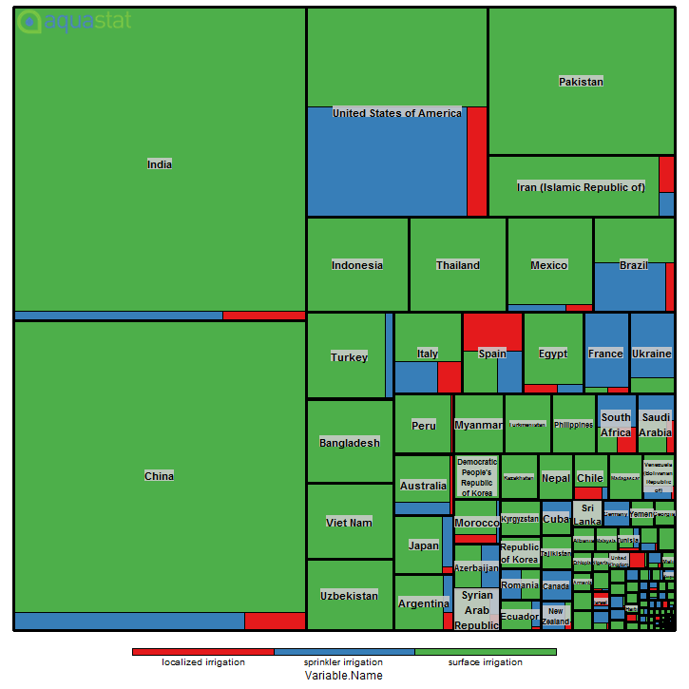
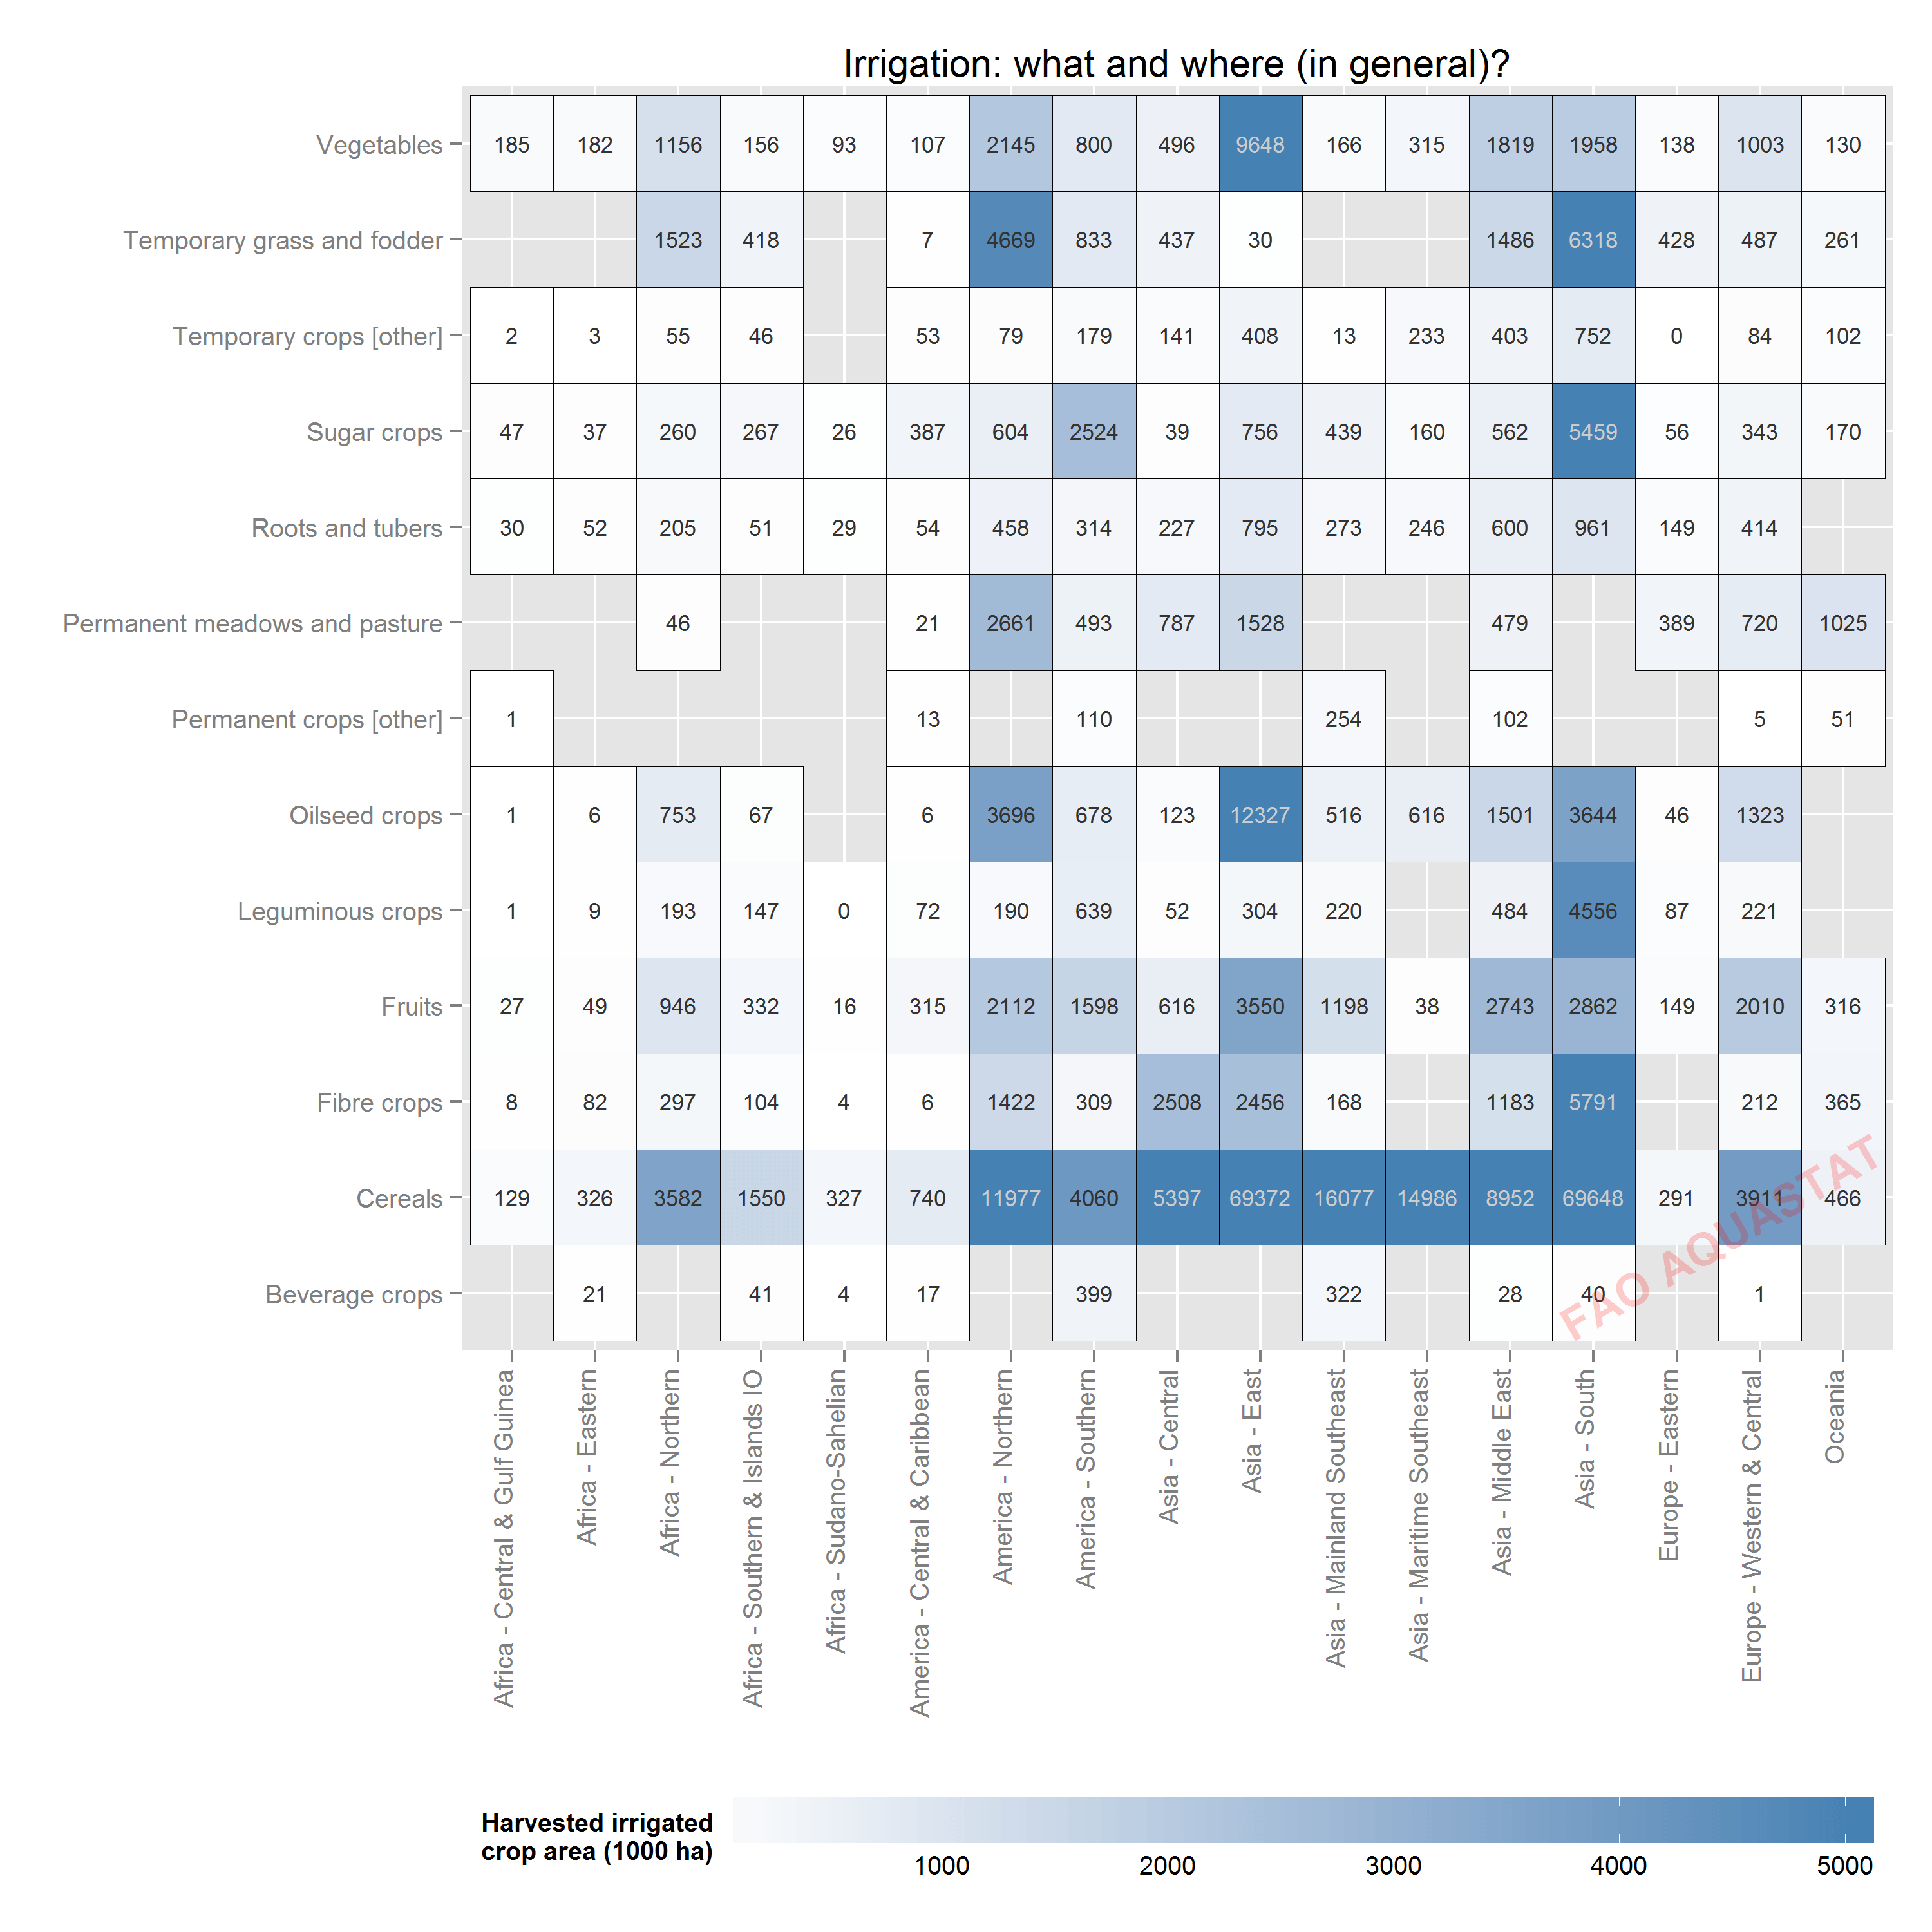
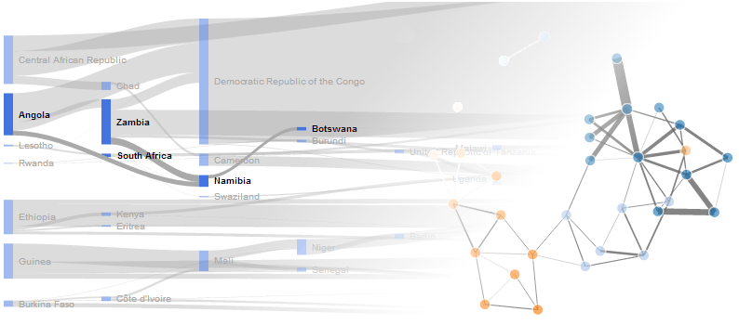

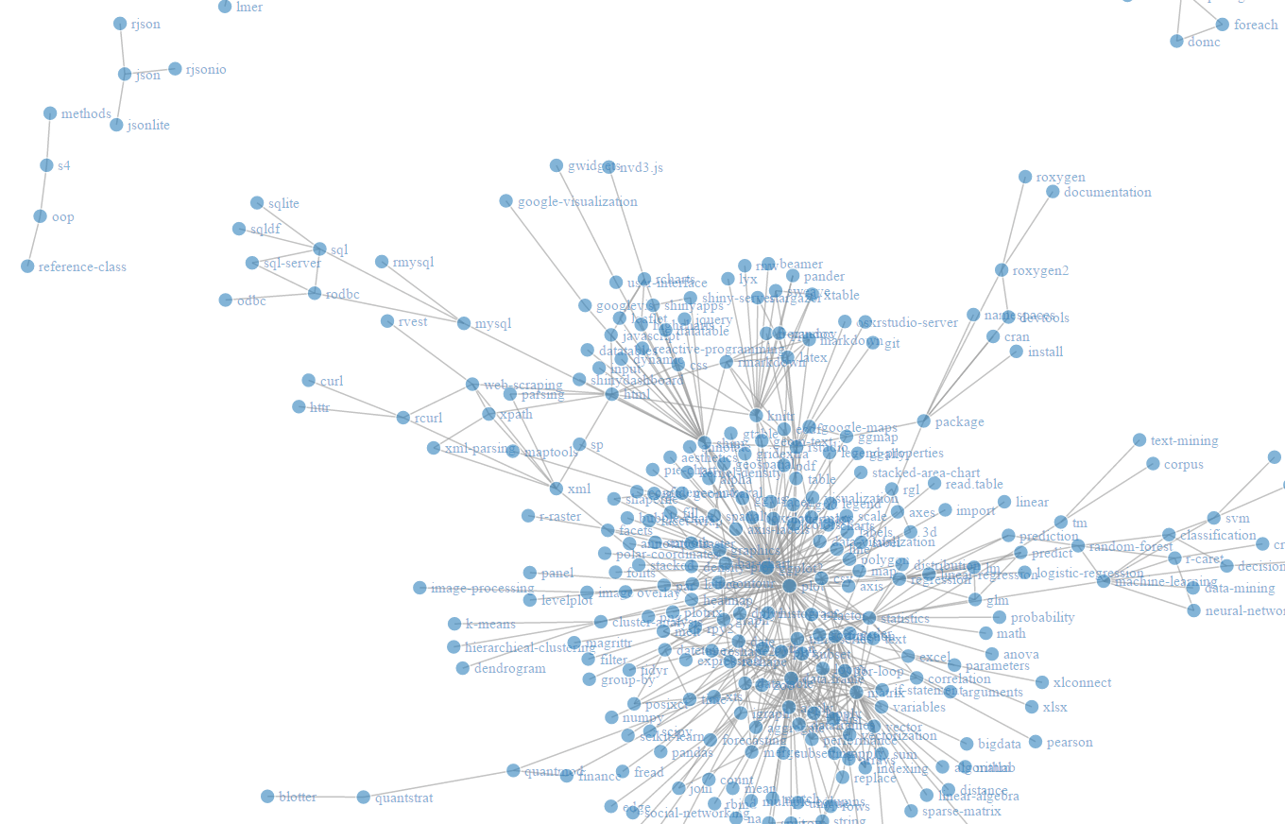
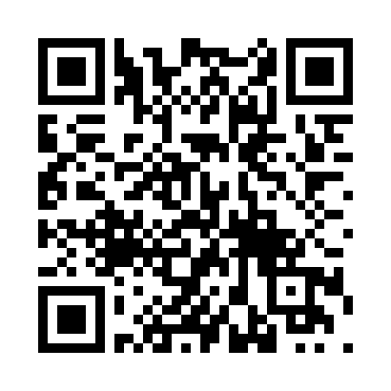
Canterbury R User Group’s
First Meetup!!
Tuesday August 15th
7:00-8:00 PM
Introduction to R, the Data Swiss Army Knife
Meetup link below!
FREE PIZZA!
Location: Fruitworks
Coworking (77 Stour Street)
https://www.meetup.com/Canterbury-R-Users-Group

